Slide 1
Movie Ratings And Box Office Dashboard
Presented By
Akshaya K P

Slide 2
Introduction
The Movie Rating and Box Office Dashboard is a data analytics project that analyses movie performance using IMDb ratings, Meta scores, audience votes, gross revenue, genres, certificates, directors, and released years of a movie. It provides interactive insights that can help users identify high-grossing movies, popular genres, highly rated movies, and audience preferences.

Slide 3
Problem Statement
The Movie Rating and Box Office Dashboard aims to analyze movie performance by examining Gross, IMDb Rating, Meta Score, audience votes, genre, director, certification, and release year. It helps identify top-performing movies, popular genres, successful directors, audience interest, and the relationship between ratings and box-office revenue.

Slide 4
Column Description
Series_Title – Name of the movie
Released_Year – Year the movie was released
Certificate – Movie certification such as U, A, UA, R, PG
Runtime – Movie duration in minutes
Genre.1 – Movie genre such as Action, Drama, Comedy
IMDB_Rating – IMDb user rating
Overview – Short description of the movie
Meta_score – Critics’ score of the movie
Director – Director of the movie
Star1–Star4 – Main actors in the movie
No_of_Votes – Number of IMDb votes received
Gross – Box-office revenue earned
Gross Group – Revenue categories created for easy analysis, such as 0–100M, 100–500M,
500M–1B, and 1B–2B.

Slide 5
Key Performance Indicator
A Key Performance Indicator (KPI) is a measurable value used to quickly understand the performance for overall Datasets.
Total Movies – Number of movies in the dataset
Average IMDb Rating – Average audience rating
Average Meta Score – Average critics’ score
Total Gross – Total box-office revenue
Average Gross – Average revenue per movie
Total Votes – Total audience votes

Slide 6
Data Preprocessing
Replaced blank Certification values with “Unknown”.
Replaced blank Meta Score values with 0.
Cleaned the Genre column by separating multiple genres and identifying the top/primary genre for each movie.
Replaced blank Gross values with 0.
Created a new Gross Group column by classifying Gross values into different revenue ranges for easy analysis.
After preprocessing, created Pivot Tables and Pivot Charts based on the defined analysis questions.

Slide 7
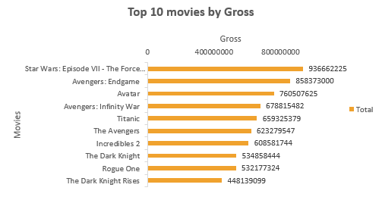
1.Which movies have the highest Gross?
This helps to identify the best-performing movies based on Gross.
Movies were placed in Rows and Gross was placed in Values.
The Gross values were sorted in descending order, and a Top 10 filter was applied to identify the movies with the highest box-office revenue.

Slide 8
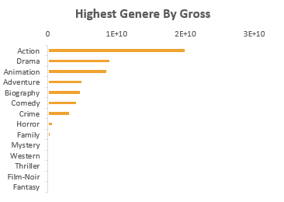
2.Which genres have the highest Gross?
Rows: Genre
Values: Gross → Sum
Sort Largest to Smallest
Top 10: Apply Top 10 filter by Gross
Helps identify: The most profitable genres based on total Gross.

Slide 9
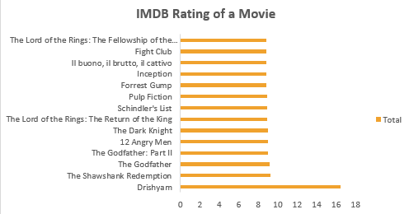
3.Which movies have the highest IMDb Rating?
Rows: Series_Title
Values: IMDB_Rating
Sort Largest to Smallest
Top 10: Apply Top 10 filter
Helps identify:The Top 10 highest-rated movies.

Slide 10
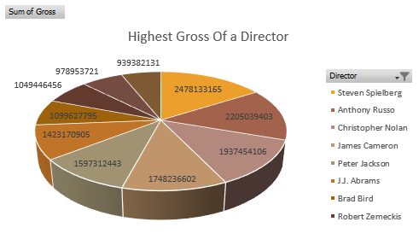
4.Which directors have the highest total Gross?
Rows: Director
Values: Gross → Sum
Sort Largest to Smallest
Top 10: Apply Top 10 filter
Helps identify: The Top 10 commercially successful directors based on total Gross.

Slide 11
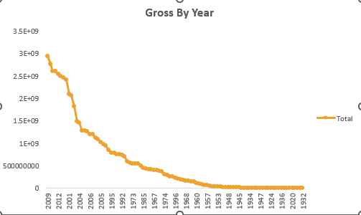
5.How does total Gross vary by year?
Rows: Released_Year
Values: Gross → Sum
Sort by Year
Helps identify: The yearly trend in total Gross.

Slide 12
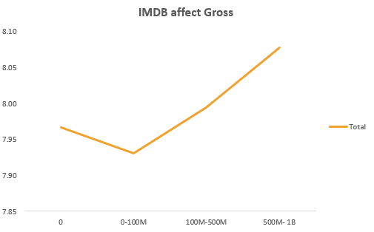
6.Does IMDb Rating affect Gross?
Values: IMDB_Rating and Gross
Create a Line Chart
Helps identify: The relationship between IMDb Rating and Gross.

Slide 13
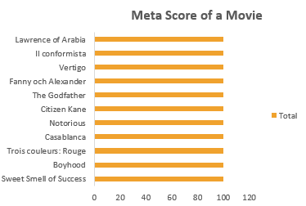
7.Which movies have the highest Meta Score?
Rows: Series_Title
Values: Meta_score → Max
Sort Largest to Smallest
Top 10: Apply Top 10 filter
Helps identify: The Top 10 movies with the highest critics' scores.

Slide 14
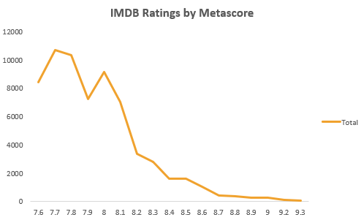
8.How does IMDb Rating compare with Meta Score?
Rows: Series_Title
Values: IMDB_Rating and Meta_score
Create a Line Chart
Helps compare: Audience ratings with critics' scores.

Slide 15
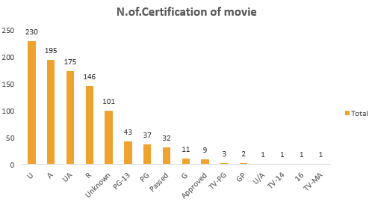
9.How many movies are there for each certification?
Rows: Certificate
Values: Series_Title → Count
Create a Column chart
Helps identify: The number of movies in each certification category.

Slide 16
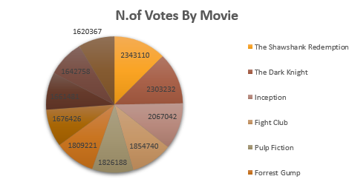
10.Which movies have the highest number of votes by movie?
Rows: Series_Title
Values: No_of_Votes
Sort Largest to Smallest
Top 10: Apply Top 10 filter
Helps identify: The Top 10 most-voted movies based on audience votes.

Slide 17

Adding Slicers
A slicer is an interactive filter that helps users quickly filter and view specific data in a dashboard. I have added Genre, Certificate, and Year slicers to the movie dashboard. These slicers help users easily filter and view specific movie data. For example, selecting “Action” in the Genre slicer shows only Action movies. This makes the dashboard interactive and helps in better analysis.
I added report connection to the all-pivot table I have Created.

Slide 18
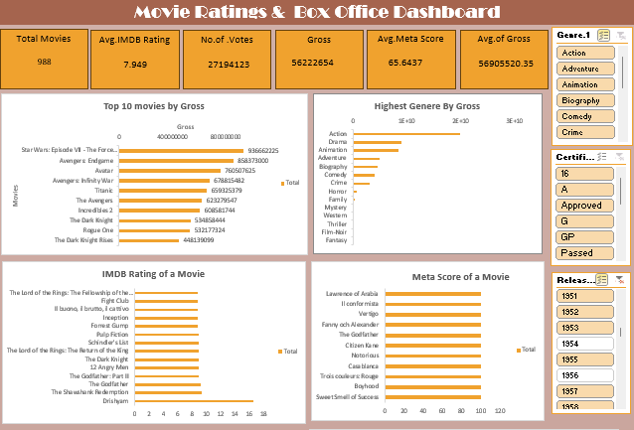
Final Dashboard

Slide 19
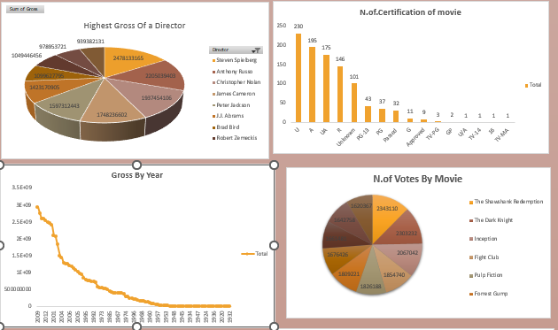

Slide 20
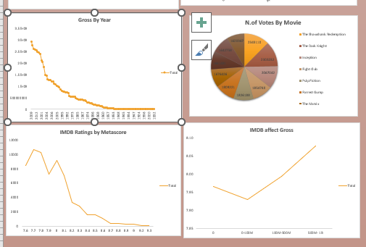

Slide 21
Conclusion
The movie dataset was analyzed using Excel PivotTables, Charts, and Slicers. The analysis helped identify top movies, genres, directors, certifications, yearly Gross, IMDb Ratings, Meta Scores, and audience votes.
Overall, the dashboard helps users explore movie performance, compare different factors, identify trends, and gain meaningful data-driven insights.

